Slide 1


DEPARTMENT OF COMPUTER SCIENCE & ENGINEERING
SCHOOL OF COMPUTING
10214CS602 MINOR PROJECT -II
WINTER SEMESTER(2023-2024)
REVIEW-II
“Vital flow Connecting Blood Donors and Blood Banks”
SUPERVISED BY
PRESENTED BY
Dr. K SEETHA LAKSHMI,M.E.,phD
Associate Professor
1.MAKIREDDY SASIDHAR REDDY (VTU19141)(21UECS0351)
2.S SAI DEEPAK REDDY (VTU19961)(21UECS0211)
3.G VENKATA SAI KRISHNA (VTU19131)(21UECS0607)

Slide 2
OVERVIEW
ABSTRACT
OBJECTIVE
INTRODUCTION
LITERATURE REVIEW (SOFT COPY OF PAPERS TO BE LINKED AS HYPERLINK)
DESIGN AND METHODOLOGIES
IMPLEMENTATION
TESTING
INPUT AND OUTPUT
INCLUDE DEMO VIDEO-1 (Till REVEW-1)
INCLUDE DEMO VIDEO-2(Complete Implementation of Project)
CONCLUSION
WEB REFERENCES LINK (TILL REVIEW DATE ALL LINKS TO BE INCLUDED DAY WISE)
PLAGIARISM REPORT OF PPT
REFERENCES

Slide 3
ABSTRACT
The project “Vitalflow Connecting Blood Donors and Blood Banks” is a website for a Blood Donation site that helps simplify the process of blood donation
By using HTML, CSS, and BOOTSTRAP along with frameworks like Node.js we created an interface that helps simplify the process of Blood Donation
MangoDB serves as the database for the “Vitalflow Connecting Blood Donors and Blood Banks” website facilitating an efficient blood donation process
The “Vitalflow Connecting Blood Donors and Blood Banks” provides a time slot booking, the location of blood bank, and the availability of blood in the blood bank

Slide 4
OBJECTIVES
Aim of the project:
To create a web application for Blood Bank
2. Scope of the project:
The website is mainly used for donating blood to emergency patients whose lives are at risk
The blood donation slots are quick and convenient, taking only 10-15 minutes
The website also includes a feature for monitoring the donated blood, indicating the specific phase it is currently undergoing
the website also has an Ai chatbot for any queries related to the website

Slide 5
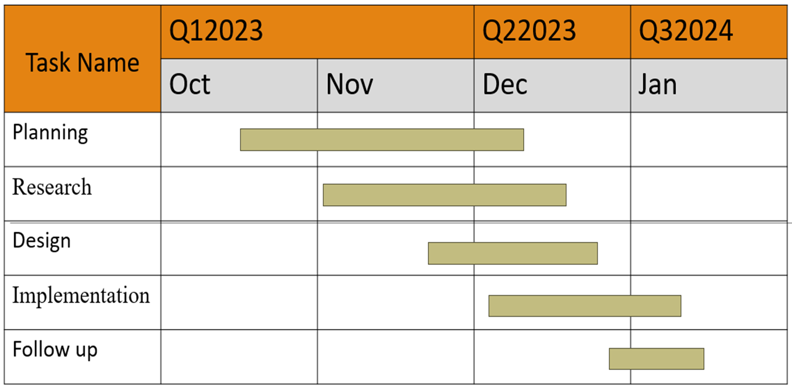
TIMELINE OF THE PROJECT
GANTT CHART

Slide 6
INTRODUCTION
The objective of the project Vitalflow Connecting Blood Donors and Blood Banks is to make blood Donation Easy with Online Booking and Location Finder
Create a user-friendly platform for donors to book specific time slots for blood donation easily.
project Vitalflow Connecting Blood Donors and Blood Banks aims to streamline blood bank management, allowing donors to effortlessly book dedicated time slots and locate the closest donation centers
For any queries related to the website there is a personal chatbot designed to guide through the website interface

Slide 7
LITERATURE REVIEW
Sl.No | Author’s Name | Paper name and publication details | Year of publication | Main content of the paper
1 | Mohammed Y. Esmail | Computerized Central Blood Bank Management System (CCBBMS)” International Conference on Computer, Control, Electrical, and Electronics Engineering (ICCCEEE) | 2018 | MohamadEsmail proposed a Computerized Central Blood Bank Management System, efficiently managing blood bank operations and integrating barcode technology.
2 | P.A.J. Sandaruwan | Towards an Efficient and Secure Blood BankManagement System,” in Humanitarian Technology Conference | 2020 | "Using k-means, GIS, and blockchain, our platform enhances blood bank efficiency and security."

Slide 8
Sl.No | Author’s Name | Paper name and publication details | Year of publication | Main content of the paper
5 | Mitesh Sarode | “Intelligent Blood Management System,” IEEE Bombay Section Signature Conference (IBSSC) | 2019 | Mitesh Sarode proposed an intelligent blood man-agement system for blood banks and hospitals, offering real-time analytics and color coding for simplified handling.
6 | Yulius Harjoseputro | “Blood Transfusion Information System Design for Blood Transfusion ServicesUnit”, Inte-rnational Journal of Innovative Technology and Exploring Engineering (IJITEE) | 2018 | "Applying discrete event simulation, this research optimizes Al-Shifa Blood Bank's daily inventory, minimizing O+ blood units' outdating and shortages, enhancing cost-effectiveness and supply sustainability."

Slide 9
Sl.No | Author’s Name | Paper name and publication details | Year of publication | Main content of the paper
5 | S.A.Alshahrani’s | .“A Relational Database Man-agement System Approach for Data Integration in Manu-facturing Process”, IEEE Inter-national Conference on Engi-neering, Technology, and Innovation (ICE/ITMC) | 2018 | S. A. Alshahrani proposed an efficient and secure blood bank management system, emphasizing the integration of efficiency and security.
6 | Lestari | “Intelligent Blood Management System”.IEEE Bombay Section Signature Conference (IBSSC) | 2019 | Blood components at the Blood Transfusion Unit to enhance health services in Indonesia, addressing chal-lenges in managing blood inventory through an information system model.

Slide 10
DESIGN AND METHODOLOGIES
MODULE 1: Gathering the Data
MODULE 2: Application Algorithm
MODULE 3: UI Elements
MODULE 4: Connections

Slide 11
MODULE 1: Gathering Data
Step:1 Collection of data
The project Vitalflow Connecting Blood Donors and Blood Banks project utilizes Express.js, a web application framework for Node.js, and Mongoose, a MongoDB object modeling tool, to seamlessly handle user registration data.
Triggered by a POST request, the ‘uploadToDB’ function asynchronously creates a new user document in the MongoDB database. This function leverages the Mongoose model and processes parsed data from the user registration form.
The implemented process ensures that crucial user information, including username, email, and password, is securely stored in the MongoDB database.

Slide 12
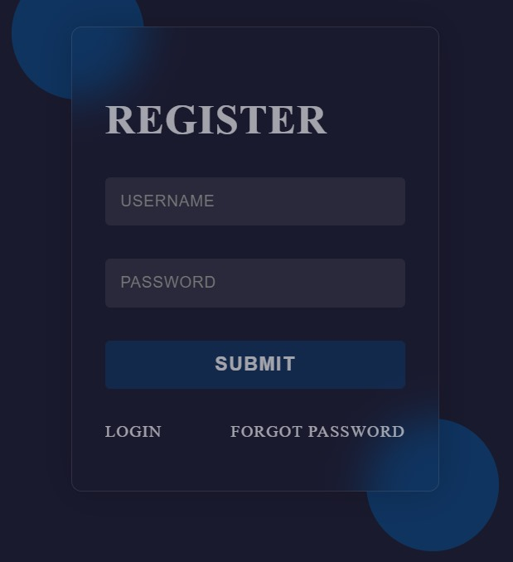
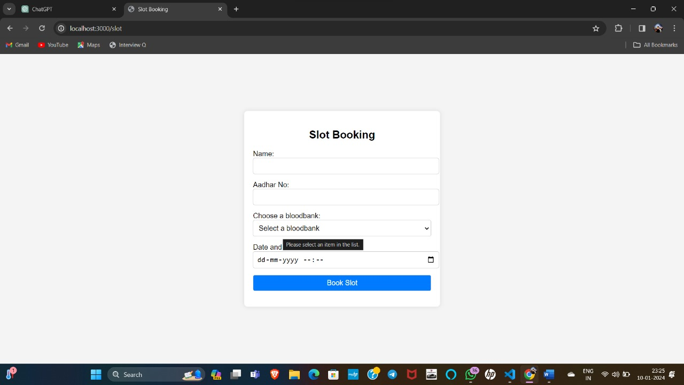

Slide 13
Step 2: Processing the data
In the project Vitalflow Connecting Blood Donors and Blood Banks application, when a user submits the login form, the ’loginnauth’ function takes charge of orchestrating the authentication process within the Express.js framework.
If a matching document is found during the authentication process in Blood Harmony, the user is redirected to the "/home" route. This redirection indicates a successful authentication, granting access to the user's home or dashboard.
If no matching document is found during the login authentication in project, the user is redirected back to the login page ("/login"). This redirection provides a feedback mechanism for unsuccessful login attempts, prompting the user to re-enter valid credentials.

Slide 14
Module 2- Mention the algorithm
The server is initialized using the Express framework, establishing a connection to a MongoDB database hosted on MongoDB Atlas through Mongoose
The server defines a user schema with fields for username, email, and password.
Key functions:‘uploadtobd’ and ’liginaunth’, are implemented for registration and login
The ‘uploadtodb’ function creates a new user document in the database
The ‘loginauth’ function verifies user credentials during login and redirects to the "/home" route upon successful authentication
Express routes are set up for different paths ("/home", "/", "/register", "/login"), and the application renders corresponding EJS templates for user interfaces.

Slide 15
Step 3: UI Elements
Step 4: User Interface
Project Vitalflow Connecting Blood Donors and Blood Banks HTML structure for displaying blood bank locations is carefully designed, utilizing sections like "container-locations" and "main-container" and incorporating semantic tags to enhance accessibility
The CSS stylesheet contributes to the visual appeal, implementing a responsive design that ensures a seamless user experience on diverse devices.
The time slot booking feature, users encounter an intuitive interface with interactive elements, such as a date/time picker or calendar, facilitating easy selection of preferred time slots.
The blood bank locations interface utilizes an intuitive design with a search bar for user convenience and an interactive map to visually represent the geographical distribution of blood banks. Each bank's details

Slide 16

Step 4: The output

Slide 17
IMPLEMENTATION
Architecture Diagram
Data –Flow Diagram
Use Case Diagram
Class Diagram
Activity Diagram
Sequence Diagram
Collaboration Diagram(If applicable)
E-R Diagram

Slide 18
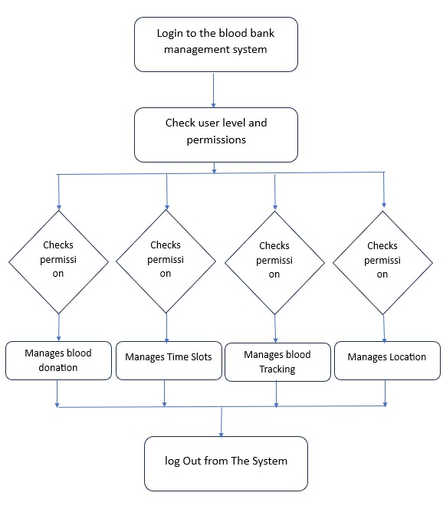
Architecture Diagram
Upon a user's login to the Vitalflow Connecting Blood Donors and Blood Banks website, the system assesses and verifies their permission levels, ensuring a secure and personalized experience. Once authenticated, users gain the capability to schedule a blood donation appointment, selecting from the available time slots tailored to their convenience, also providing AI assistance.
the website provides users with comprehensive access to essential information regarding the locations of nearby blood banks. This feature enables users to easily locate and navigate to the most accessible blood donation centers.
hospitals can effortlessly retrieve real-time information on donor blood in the website using blood tracking function

Slide 19
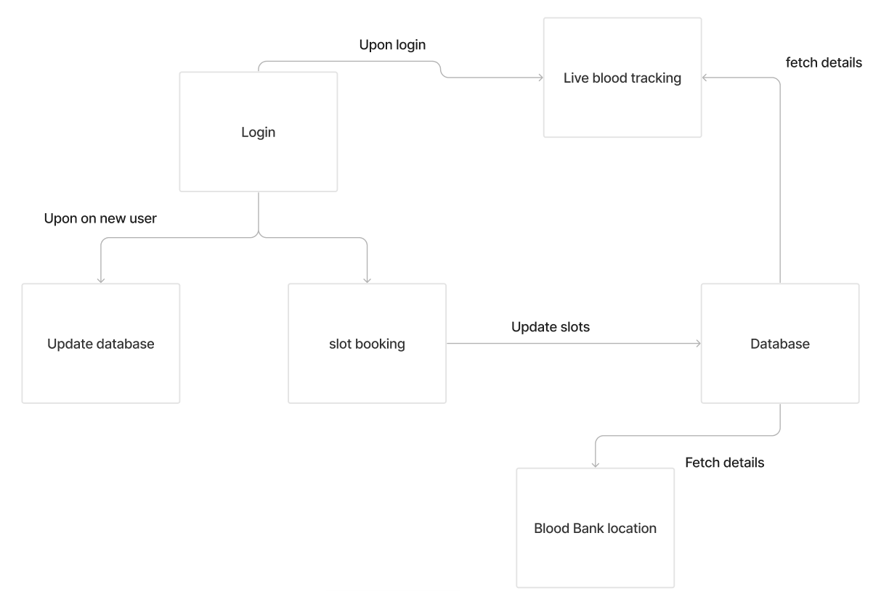
Data –Flow Diagram
During registration information of user inputs like username, password
The Vitalflow Connecting Blood Donors and Blood Banks system systematically stores user data within a dedicated user database, ensuring a structured and organized repository for user information.
Website uploads the user data collected during registration onto its dataset, facilitating a smooth transition of information from the internal database to the user interface.

Slide 20
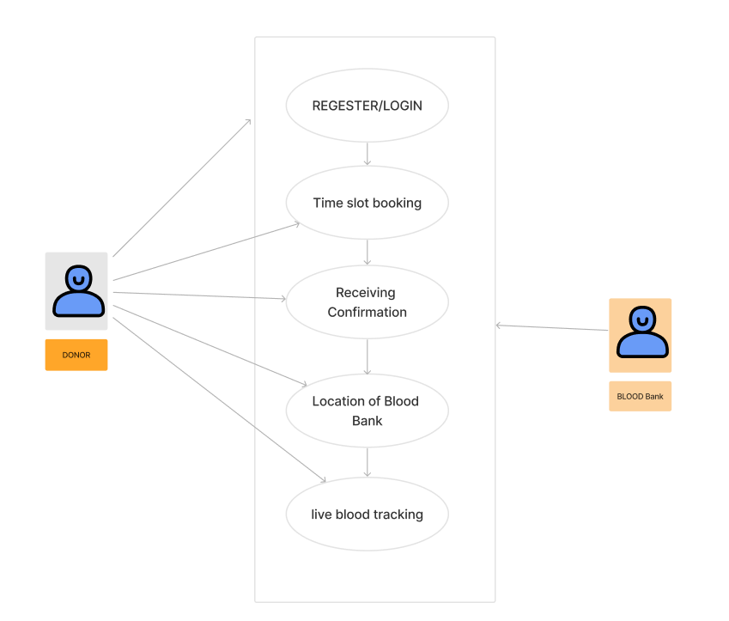
Use Case Diagram

Slide 21
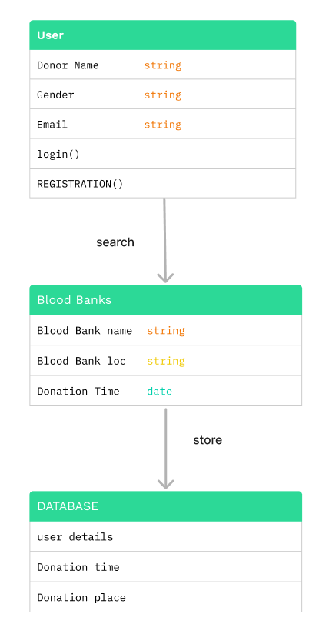
Class Diagram

Slide 22
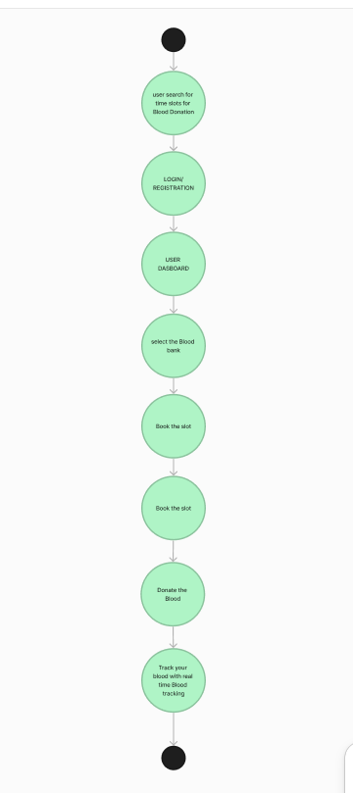
Activity Diagram

Slide 23
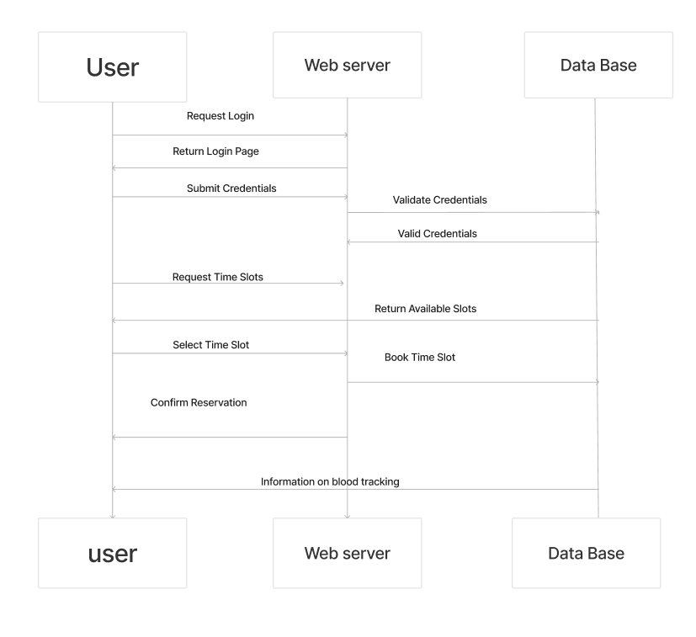
Sequence Diagram

Slide 24
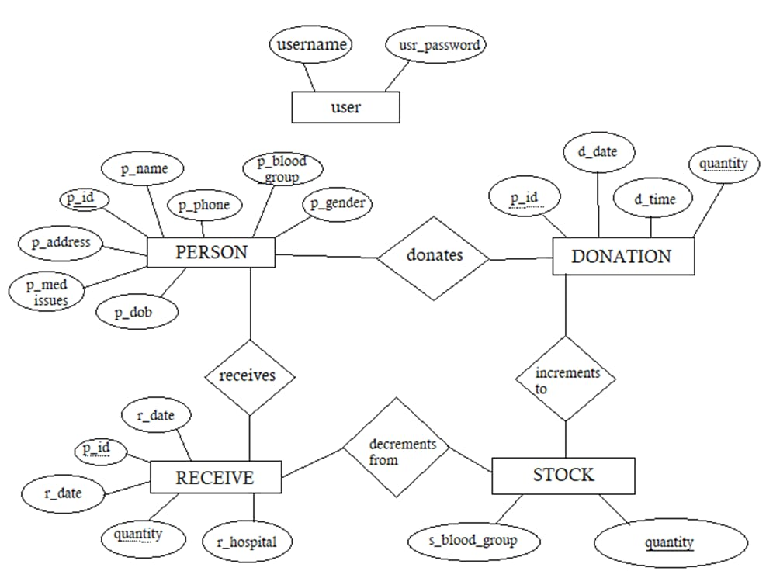
E-R Diagram

Slide 25
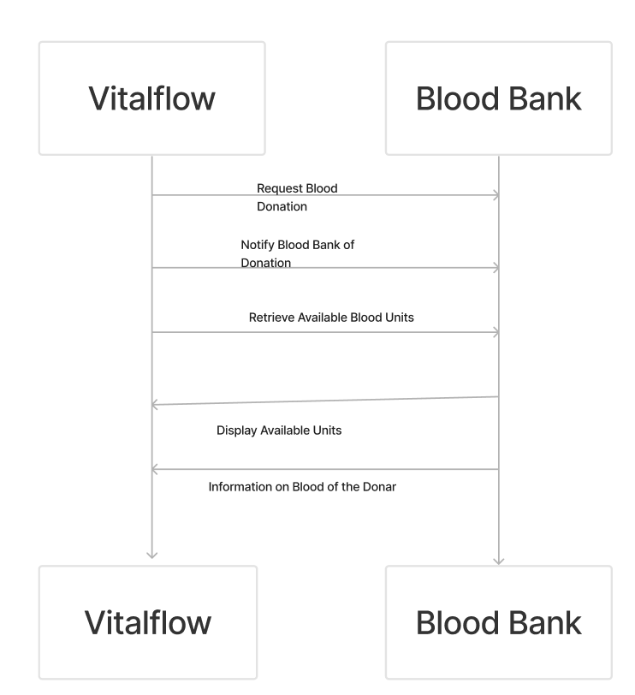
Collaboration Diagram(If applicable)

Slide 26
TESTING
UNIT TESTING
INTEGRATION TESTING
FUNCTIONAL TESTING
WHITE BOX TESTING
BLACK BOX TESTING

Slide 27
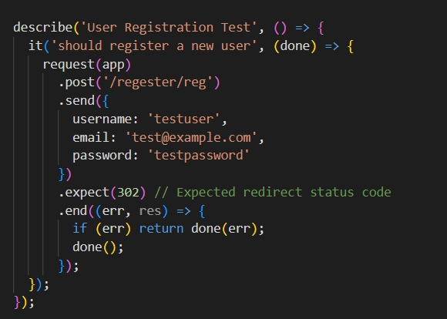
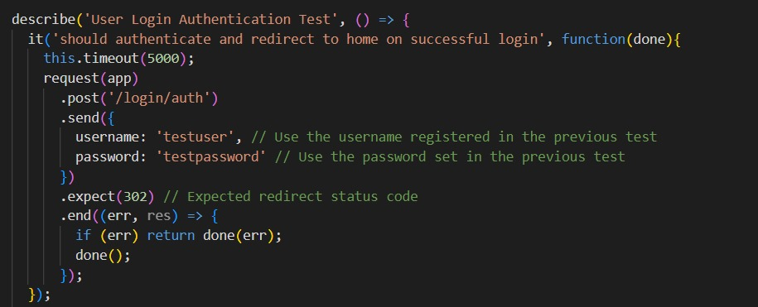
UNIT TESTING
INTEGRATION TESTING

Slide 28
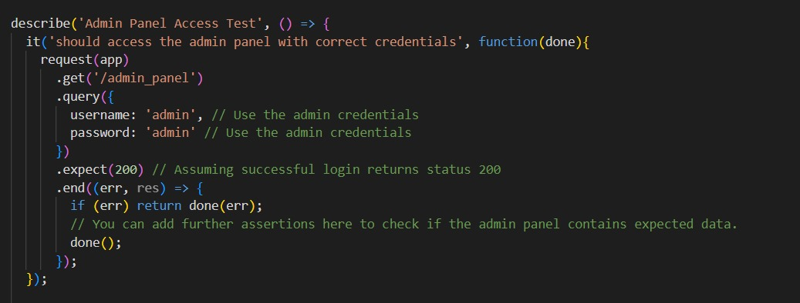
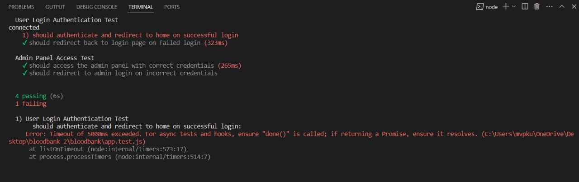
SYSTEM TESTING
FUNCTIONAL TESTING

Slide 29
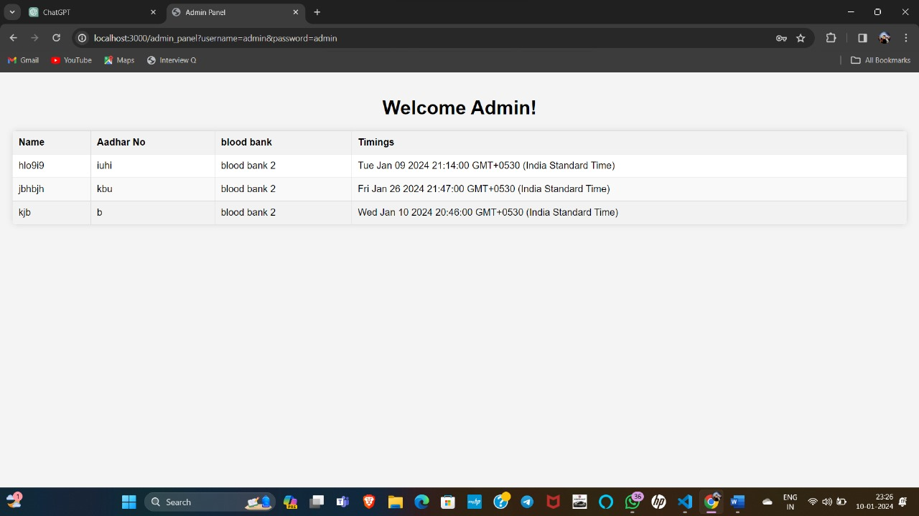
INPUT AND OUTPUT

Slide 30
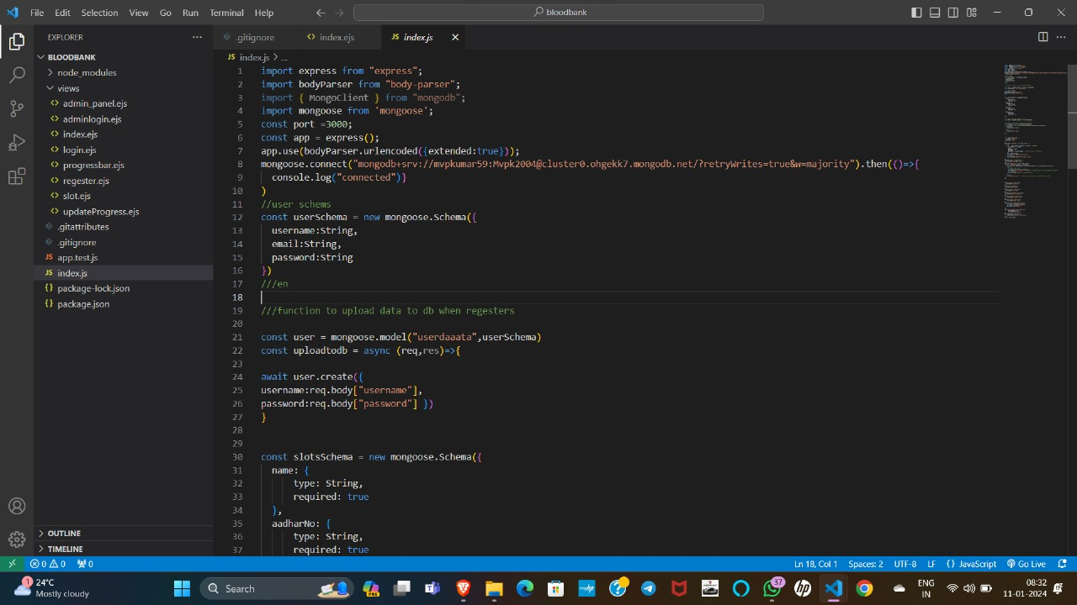
SOURCE CODE

Slide 31
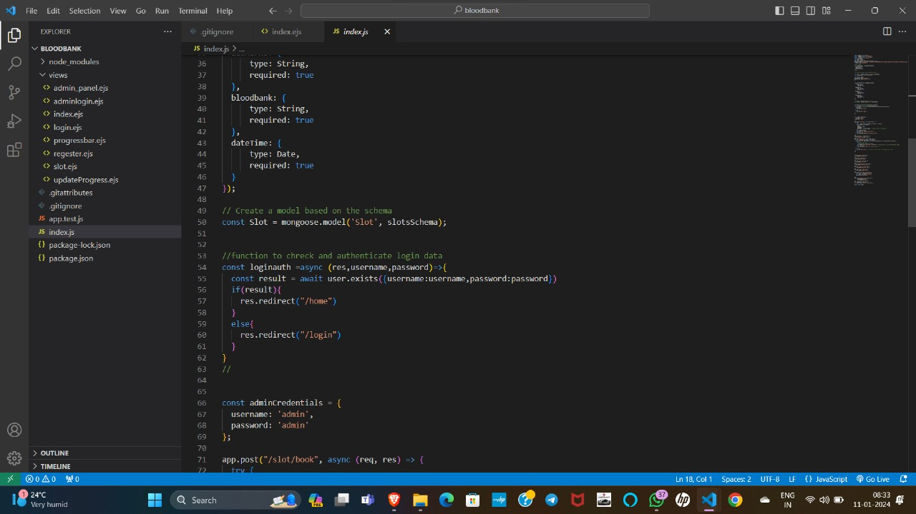
SOURCE CODE

Slide 32
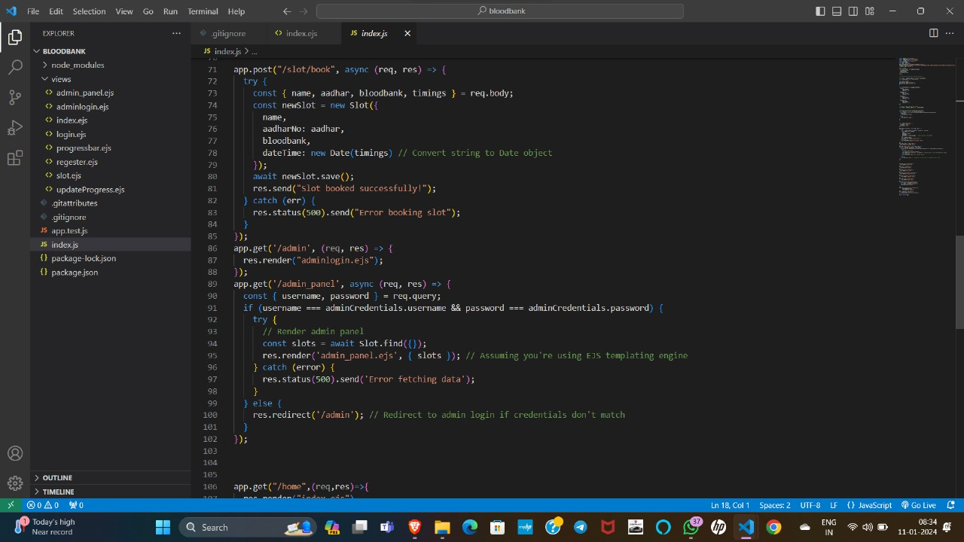
SOURCE CODE

Slide 33
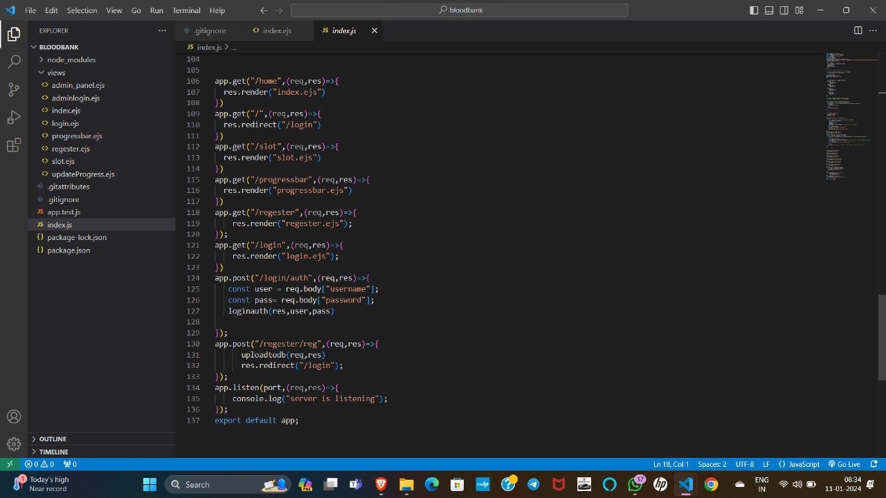
SOURCE CODE

Slide 34
OUTPUT

Slide 35
CONCLUSION
Vitalflow Connecting Blood Donors and Blood Banks is designed to simplify blood donation. Through our user-friendly website, donating blood has never been easier or more stress-free.
platform allows you to effortlessly schedule a donation appointment at your convenience and provides clear directions to nearby blood banks, ensuring you always know where to go.
website is integrated with innovative features like an intuitive track bar, guiding you through each step of the donation process. With our smart time slot system.
location feature ensures you find the nearest blood bank effortlessly. Beyond technology, Blood Harmony is a commitment to positively impact healthcare by leveraging tech to aid people.
To creates a friendly and accessible experience, supported by an AI bot ready to answer any queries.

Slide 36
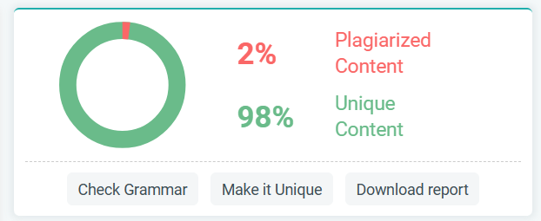
Plagiarism Report of PPT

Slide 37
Web references/video links
https://www.redcrossblood.org/blood-donor-app.html
https://www.redcrossblood.org/donate-blood/blood-donation-process/what-happens-to-donated-blood.html
NodeJS Tutorial | Learn NodeJS - GeeksforGeeks
https://www.youtube.com/watch?v=zAfLcKrbSps&list=PPSV

Slide 38
REFERENCES
[1] Mohammed Y. Esmail; Yousra Sayed Hammad Osman “Computerized Central Blood Bank Management System (CCBBMS)” International Conference on Computer, Control, Electrical, and Electronics Engineering (ICCCEEE), Aug 2018
[2] P.A.J. Sandaruwan, U.D.L. Dolapihilla “Implementation of a Blood Cold Chain System Using Blockchain Technology”, Journal of Applied Sciences, May 2020.
[3] Mitesh Sarode, “Intelligent Blood Management System,” IEEE Bombay Section Signature Conference (IBSSC), Mumbai, India, 2019.
[4] Yulius Harjoseputro “Blood Transfusion Information System Design for Blood Transfusion ServicesUnit”, International Journal of Innovative Technology and Exploring Engineering (IJITEE), Sep 2018.

Slide 39
[5] S.A.Alshahrani’s, A. Espostito, M. Massafra, A. Totaro. “A Relational Database Management System Approach for Data Integration in Manufacturing Process”. 2018 IEEE International Conference on Engineering, Technology and Innovation (ICE/ITMC)
[6] Lestari, Mitesh Ghanekar, Ayush Krishnadas, Sahil Patil, Yash Parmar, Manish (2019). “Intelligent Blood Management System”.IEEE Bombay Section Signature Conference (IBSSC)
[7] Diana Hawashin, Khaled Salah, Mazin debe “Blockchain-Based Management of Blood Donation” DEC 2021.
[8] Ulfah, Fitri Roza Aprianis, Suherman Suherman “Inventory Management Information System in Blood Transfusion Unit”, IEEE International Conference on Industrial Engineering and Engineering Management (IEEM), Bangkok, Thailand, Dec 2018.

Slide 40
THANK YOU

